Slide 1
MCTV LTD

Slide 2
Introduction to our Company
MCTV Limited is a small retail company based in Limerick with a turnover of €1 million per annum & staff of five people that is in the business of selling televisions.
The company was established by Michael Cooney and his wife Doreen and has been trading for over twenty years as a private limited family run company.

Slide 3
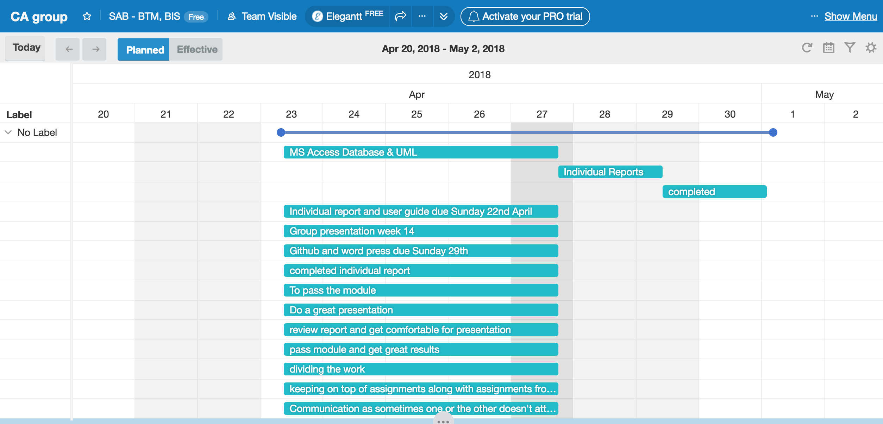
Who did what? Gaant Chart

Slide 4
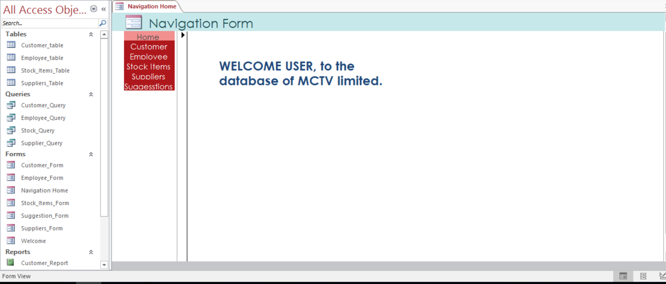
MCTV Database

Slide 5
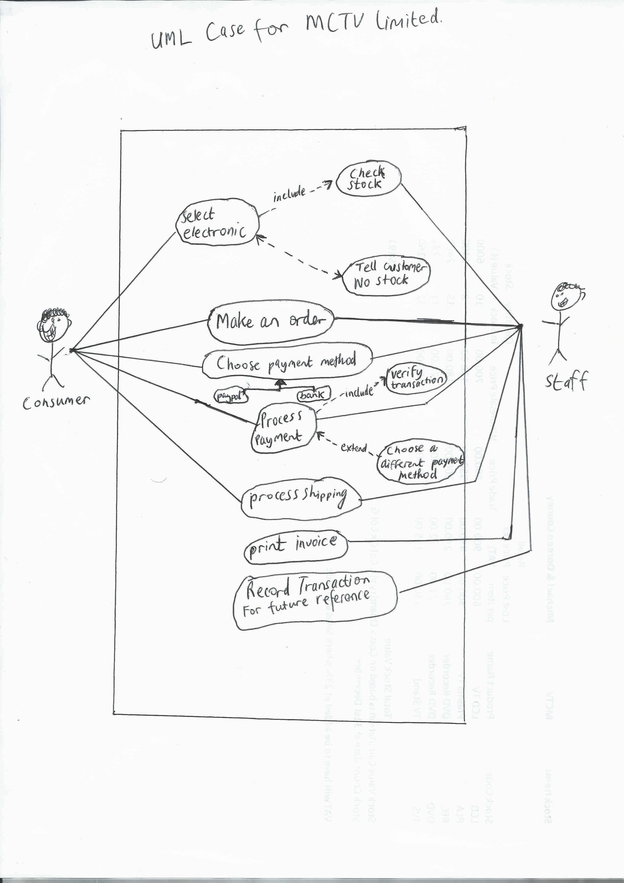
UML case for database…

Slide 6


Mohaned- Sage line 50 user guide

Slide 7
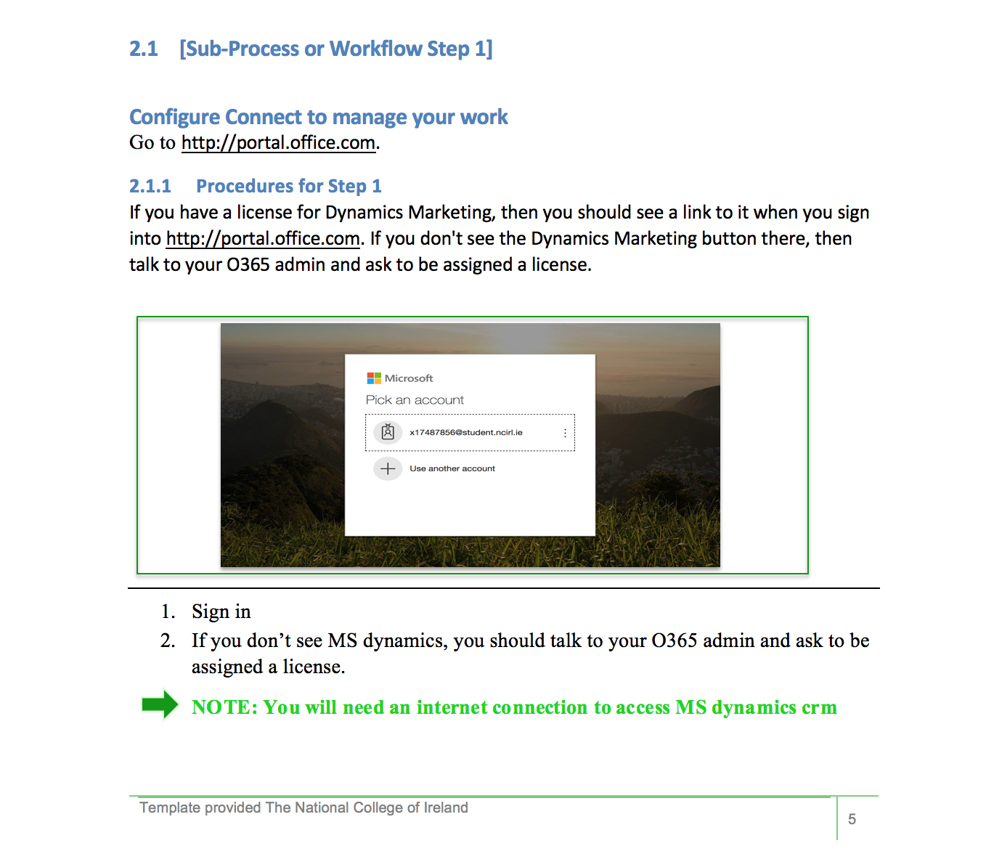
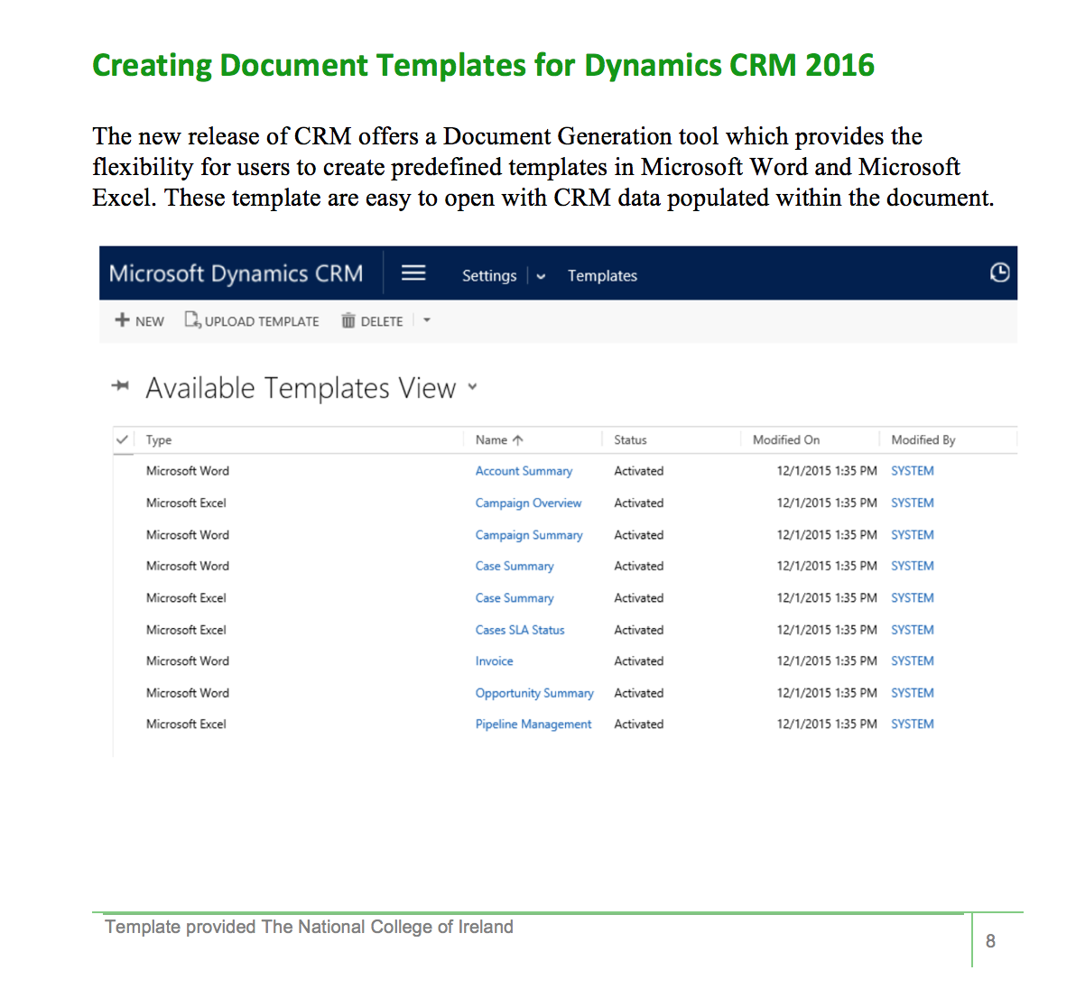
Daniel- MS dynamics

Slide 8
Branding- Color scheme
We chose the colors green and white in the database and presentation because the colors are bright.
These colors represent Ireland and our culture.
This color scheme has primary colors which make it simple and easy to read.

Slide 9
Conclusion
The future for MCTV ltd is an organized cloud system which I will carefully explain.
Thank you for listening to this presentation…

